Slide 1
Converting Casual Riders to Annual Members
Cyclistic
March 2024

Slide 2
The problem
Company
Context
Problem
Cyclistic: Launched in Chicago 2016.
Offerings: Bike-share program with 5,824 bicycles, including standard, reclining bikes, hand tricycles, and cargo bikes.
Current Strategy: Appeal through flexible pricing plans: single-ride passes, full-day passes, and annual memberships.
Financial Insight: Annual members are significantly more profitable than casual riders.
Goal: Focus on understanding the differences between casual riders and annual members to facilitate conversion by utilizing historical bike trip data provided by Cyclistic for insights.
Objective: Shift focus towards converting casual riders into annual members to drive growth.

Slide 3
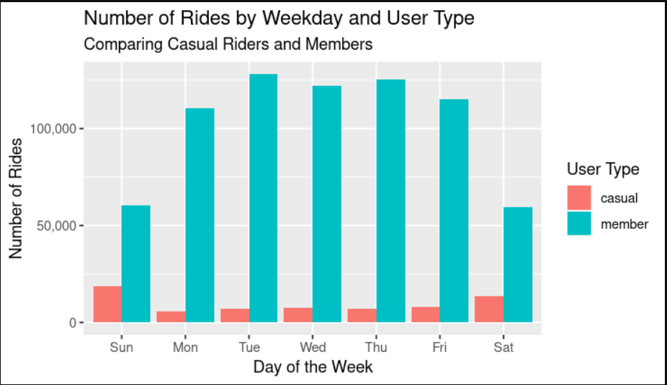
Members ride more overall compared to casual riders.
Members take the most rides during the weekday.
Casuals ride more on saturday sunday when compared to Monday - Friday

Slide 4
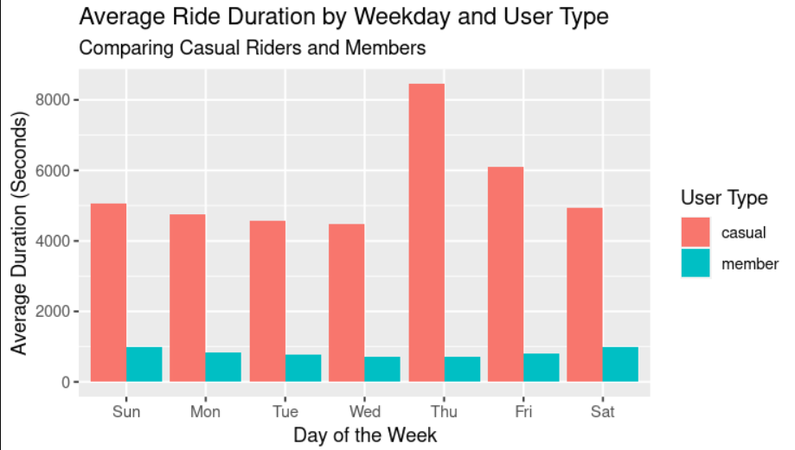
Casual riders ride take longer bike rides compared to those that are members
Members average duration throughout the week is are a similar level
The average duration in seconds for members was 795. For casual riders it was 5373

Slide 5
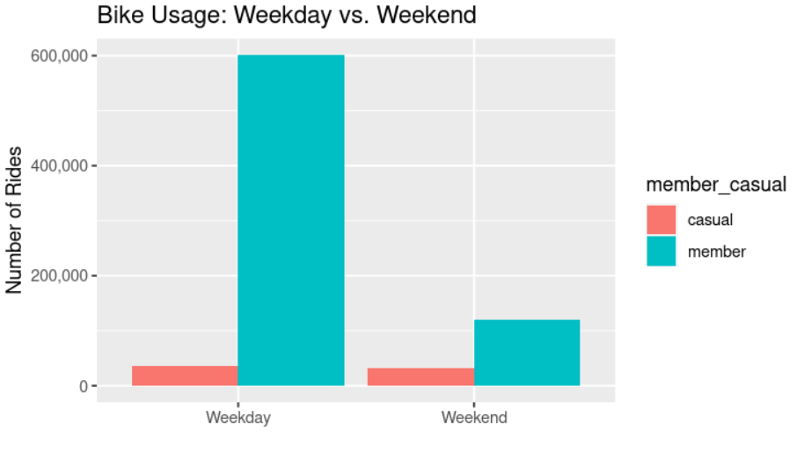
Members take the most amount of rides during the weekday compare to the weekend
Casual riders have a similar amount of rides shared when comparing weekend and weekday; even though there are more days in the weekday.

Slide 6
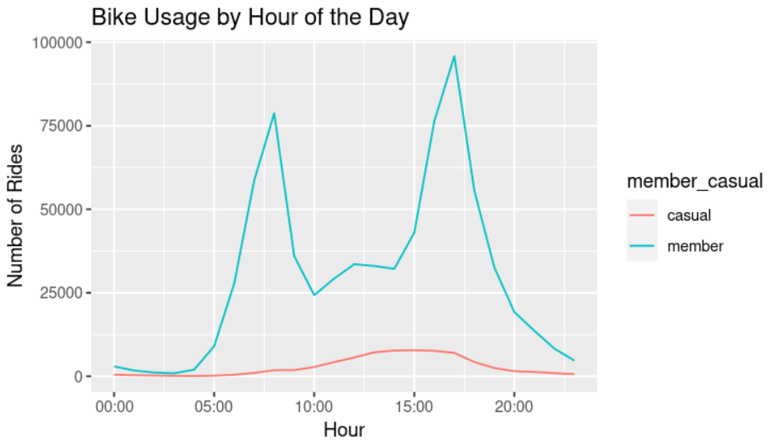
Members tend to use the most rides at around 07:00 and 17:00; which are the times of going to and coming off of work

Slide 7
Recommendation 1:
Marketing Campaigns for Commuting Benefits
Given that members use bikes for commuting mainly on weekdays, specifically around standard work hours (8:00 AM and 5:00 PM), we can design marketing campaigns aimed to convince casual riders riding a bicycle more frequently can cause convenience, cost-effectiveness, health benefits, and have a positive effect on the environment.
Environmental Impact: Show how choosing bike-share over cars for daily commutes can reduce carbon footprints.
Health Benefits: Promote the physical health benefits of daily cycling.
Economic Savings: Compare the cost of annual memberships with other forms of daily transportation (e.g., public transit, car parking, fuel).
Convenience and Reliability: Highlight the availability and accessibility of the bike-share system.

Slide 8
Recommendation 2:
Weekend Promotions and Incentives
Since casual riders show a slight increase in rides during the weekend, we can introduce weekend promotions or incentives that are exclusive to members.
Discounted Group Rides: We can encourage casual riders to become members by offering discounts on group rides and family plans on weekends.
Loyalty Points: Implement a loyalty program where rides on weekends earn more points towards rewards, discounts, or free rides.
Special Weekend Events: Organize member-exclusive bike tours, scavenger hunts, or partnered events with local businesses to add value to the membership beyond the utility of commuting.

Slide 9
Recommendation 3:
Flexible Membership Plans with Trial Periods
Considering the difference in ride duration and the preference for weekend usage among casual riders, we can offer flexible membership plans that cater to diverse needs.
Trial Memberships: We can offer a one-month trial membership at a discounted rate, allowing casual riders to experience the benefits of being a member without a long-term commitment.
Tiered Memberships: Create different levels of memberships that vary by ride duration, number of rides per month, or other perks to appeal to the varying usage patterns of casual riders.
Weekender Plans: Introduce a special membership plan tailored for those who prefer to ride on weekends, with added benefits or discounts for rides on these days.

Slide 10
Conclusion
Our analysis reveals a clear difference in how casual riders and members engage with Cyclistic. By tailoring our approach to align with these insights, we can convert more casual riders into members, driving growth and strengthening our impact in the community.
We must act on these insights to not only convert casual riders into annual members but also to reinforce Cyclist's position as a leader in sustainable urban mobility. Together, we can shape the future of city commuting, making it healthier, more economical, and environmentally friendly for everyone.

